Slide 1
Capstone Project
Zomato Restaurant Clustering and Sentiment Analysis By
Girish R

Slide 2
Content
Introduction
Problem Statement
Data Summary
Approach Overview
Exploratory Data Analysis
Modelling Overview
Conclusion
Notes:
A short introduction of zomato
Given problem statement
overview of approach that we followed

Slide 3
Introduction
In today's competitive restaurant industry, it is crucial for companies to understand the market and target the right audience in order to drive growth and success. This project aims to provide a comprehensive solution to this problem by utilizing advanced data analytics and machine learning techniques to cluster Zomato restaurants into segments based on various factors such as cuisine and cost. By understanding the market segments, the company will be able to target the right audience and make data-driven decisions. Additionally, the project will also analyze customer sentiment and reviews, which will account for 40% of the project, to extract valuable insights and identify areas for improvement that can increase customer satisfaction. Overall, this project aims to empower the restaurant industry with a thorough understanding of the market and actionable recommendations for driving business growth.

Slide 4
Problem Statement
Create hotel clusters based on cuisines and sentiment analysis of the customer reviews
The problem statement of the project is to help the restaurant industry understand the market and target the right audience to drive growth and success by utilizing advanced data analytics and machine learning techniques to cluster Zomato restaurants into segments based on various factors such as cuisine and cost, and analyze customer sentiment and reviews to extract valuable insights and identify areas for improvement that can increase customer satisfaction.

Slide 5
Data Summary
Zomato Restaurant names and Metadata (clustering)
Name: Name of Restaurants
Links: URL Links of Restaurants
Cost: Per person estimated Cost of dining
Collection: Tagging of Restaurants w.r.t. Zomato categories
Cuisines: Cuisines served by Restaurants
Timings: Restaurant Timings

Slide 6
Data Summary
Restaurant: Name of the Restaurant (sentiment analysis )
Reviewer: Name of the Reviewer
Review: Review Text
Rating: Rating Provided by Reviewer
MetaData: Reviewer Metadata - No. of Reviews and followers
Time: Date and Time of Review
Pictures: No. of pictures posted with the review

Slide 7
Pipeline
Data Cleaning
Data Exploration
Modeling
Understanding and Cleaning
Null value analysis
Missing value treatment
Outlier Treatment
Graphical
Univariate analysis with visualization
Bivariate Analysis
with visualization
Machine Learning
Clustering
Sentiment Analysis
Recommendation System
Notes:
Topic modeling or unsupervised sentiment analysis
Classification or supervised sentiment analysis

Slide 8
Basic Exploration
Data of 105 restaurants.
Data of 9000 reviews
3 years of customer’s reviews
0.36 percent null values were present.
50 percent of collection data is missing
Average price of a Restaurant ranges from 150 to 2800
Notes:
0.36 percent of null values were present in reviews data
50 percent of collection data is missing which contained the taggs given by zomato to a restaurant

Slide 9
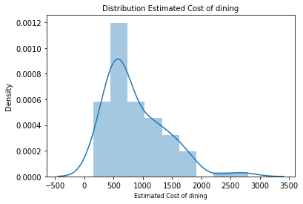
Univariate Analysis
We utilized a distribution plot to see how the cost of dining varied across all restaurants.
From the cost distribution curve it can be observed that most of restaurants have cost of dinning in the ranging from Rs.200-Rs.1000 and the median cost is around Rs.700.

Slide 10
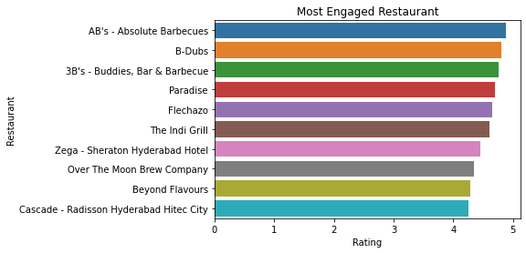
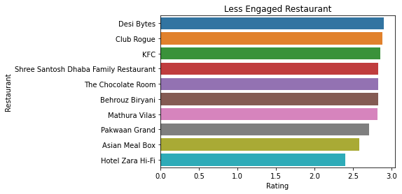
Price Point and Maximum Engagement
AB's - Absolute Barbecues, show maximum engagement and retention as it has maximum number of rating on average and Hotel Zara Hi-Fi show lowest engagement as has lowest average rating.

Slide 11
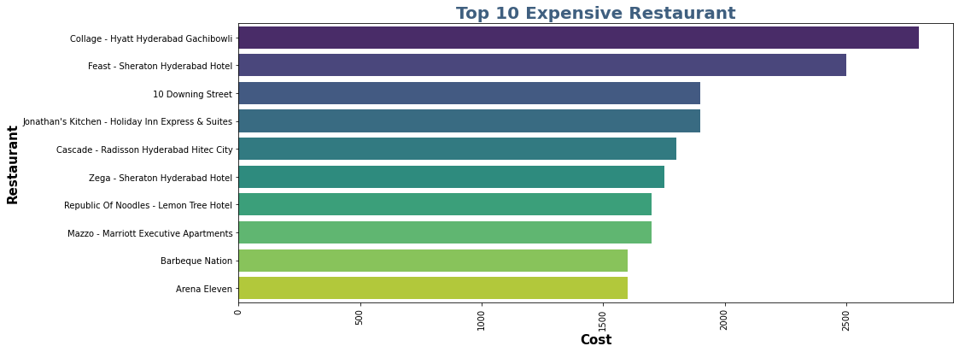
10 Most expensive Restaurants
From the above graph we can see the top 10 expensive hotels with Collage-Hyatt Hyderabad Gachibowli being in the top as the most expensive one followed by Feat-Sheraton Hyderabad Hotel

Slide 12
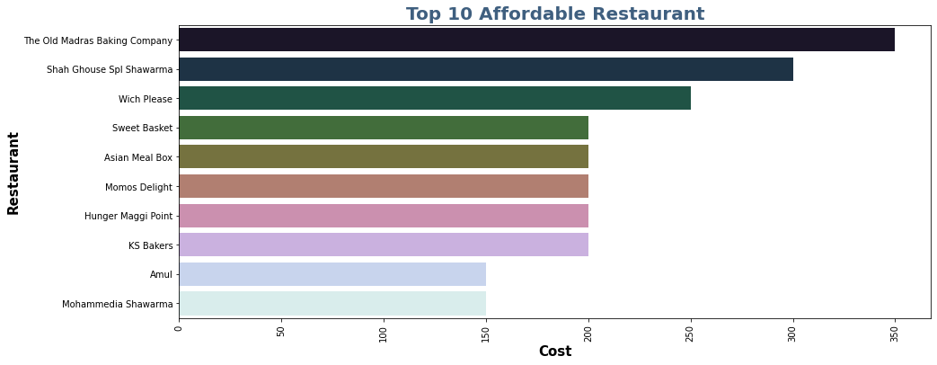
10 most Affordable Restaurants
From the above graph we can see the affordable Restaurants with The old Madras Baking Company at the top which is most affordable according to the given dataset

Slide 13
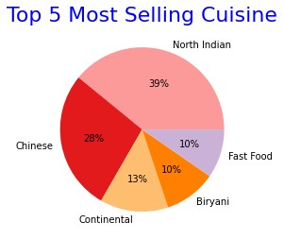
5 Most Served Cuisines
Based on the chart it is clear that most of the hotel sell North Indian food followed by chinese.

Slide 14
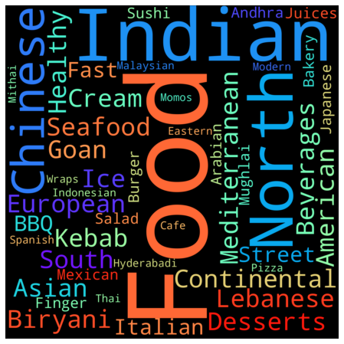
Frequent Keyword Used for cuisine

Slide 15
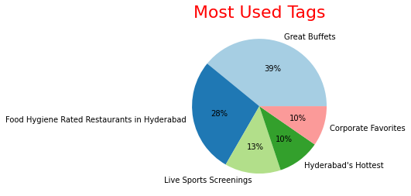
Most used tags for Restaurants
Great Buffets is the most frequently used tags and other tags like great, best, north, Hyderabad is also used in large quantity.

Slide 16
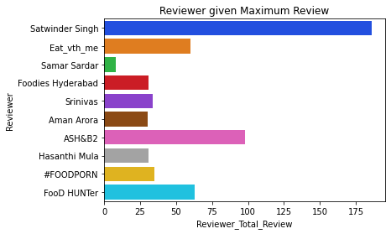
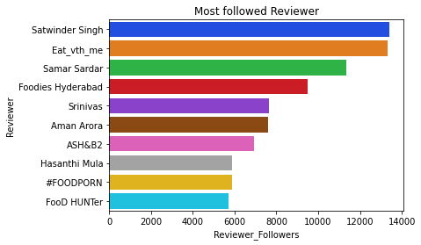
Most Popular Critics
Satwinder singh is the most popular critic who has maximum number of follower and on an average he give 3.5 rating

Slide 17
Modelling Overview
Models Used :
K-means Clustering
Hierarchical Clustering
Sentimental Analysis (Unsupervised)
LDA(Latent Dirichlet Allocation)
Sentimental Analysis (Supervised)
Logistic Regression
XGBooster
Recommendation System

Slide 18
Modeling Steps
Model Evaluation
Data Preprocessing
Data Fitting and Tuning
Feature selection
Feature engineering
Feature Extraction
Train test data split(80%-20%)
Start with default model parameters
Hyperparameter tuning
Measure scores on training & test data
Model testing
Compare models

Slide 19
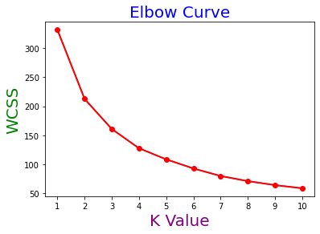
K Means Clustering Plots
I applied K means Clustering to cluster the Restaurants based on the given features. I used both the Elbow and Silhuoette Methods to get an efficient number of K, and we discovered that n clusters = 6 was best for our model.
After labelling the clusters, we visualised them and counted the number of restaurants in each cluster, discovering that the majority of the restaurants belonged to the first cluster.

Slide 20
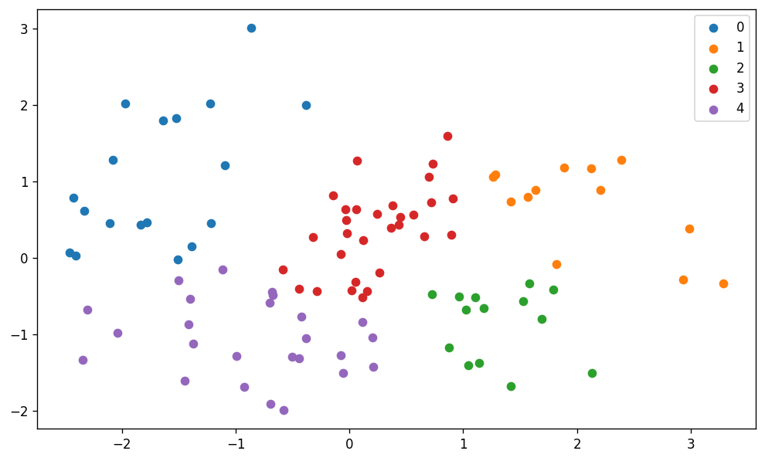
Visualizing the clusters and the datapoints in each clusters

Slide 21
Cuisines in different clusters (K Means)
Cuisine List for Cluster : 0
['Biryani' 'North Indian' 'Chinese' 'Asian' 'Mediterranean' 'Desserts' 'Continental' 'Seafood' 'Goan' 'Kebab' 'BBQ' 'European' 'American' 'Italian' 'South Indian' 'Modern Indian' 'Sushi']
Cuisine List for Cluster : 1
['Lebanese' 'Ice Cream' 'Desserts' 'North Indian' 'Fast Food' 'Asian' 'Beverages' 'Bakery' 'Momos' 'Pizza' 'Street Food' 'Arabian']
Cuisine List for Cluster : 3
['Continental' 'American' 'Chinese' 'North Indian' 'Italian' 'Finger Food' 'Andhra' 'South Indian' 'Arabian' 'Biryani' 'Cafe' 'Desserts' 'Bakery' 'Fast Food' 'Wraps' 'Asian' 'Momos' 'Hyderabadi' 'Mughlai' 'Beverages' 'Burger' 'Salad' 'North Eastern' 'Seafood']
Cuisine List for Cluster : 2
['Street Food' 'North Indian' 'Fast Food' 'Burger' 'Chinese' 'Biryani' 'Mughlai' 'South Indian' 'Desserts' 'Kebab' 'Cafe']
Cuisine List for Cluster : 4
['Chinese' 'Continental' 'Kebab' 'European' 'South Indian' 'North Indian' 'Biryani' 'Seafood' 'Beverages' 'Healthy Food' 'American' 'Japanese' 'Italian' 'Salad' 'Sushi' 'Mexican' 'Bakery' 'Mughlai' 'Juices' 'Andhra' 'Hyderabadi' 'Spanish' 'Finger Food' 'Thai' 'Indonesian' 'Asian' 'Momos' 'Desserts' 'Cafe' 'Burger' 'Fast Food']

Slide 22
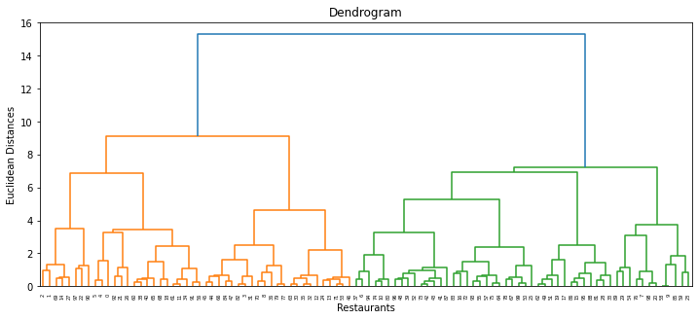
Hierarchical Clustering
The dendrogram is a tree-like structure that is mainly used to store each step as a memory that the HC algorithm performs. In the dendrogram plot, the Y-axis shows the Euclidean distances between the data points, and the x-axis shows all the data points of the given dataset.

Slide 23
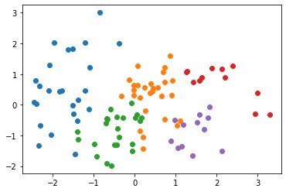
Agglomerative Hierarchical Clustering
I have used Hierarchical Clustering - Agglomerative Model to cluster the restaurants based on different features. This model uses a down-top approach to cluster the data. I have used Silhouette Coefficient Score and used clusters = 6 and then visualized the clusters and the datapoints within it.
Silhouette Coefficient: 0.247 davies_bouldin_score: 1.151

Slide 24
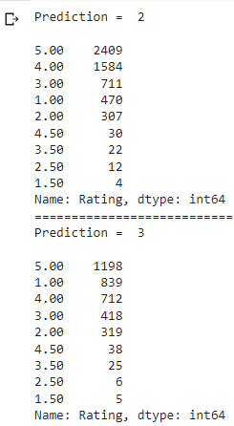
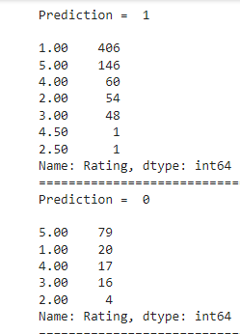
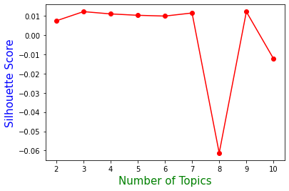
Sentimental Analysis (Unsupervised) LDA
LDA(Latent Dirichlet Allocation) is an unsupervised learning algorithm, it doesn't have any predefined labels. The labels are assigned based on the analysis done on the words, the weights of the words, and the context of the words in each topic.

Slide 25
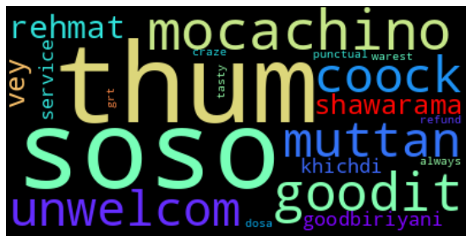
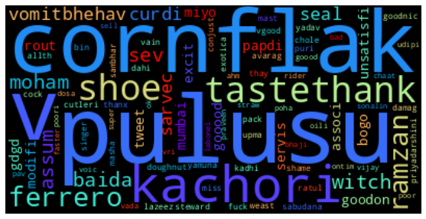
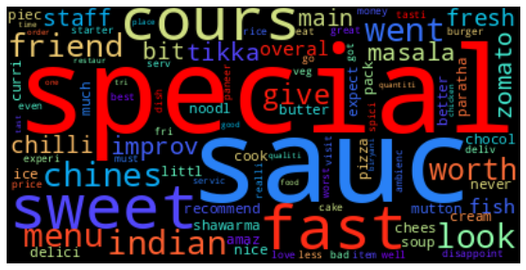
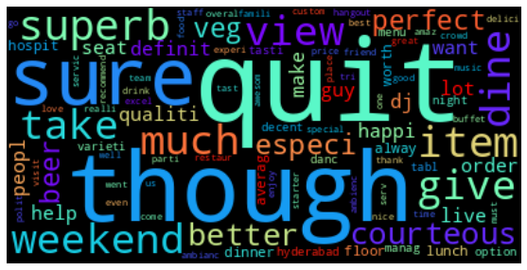
TOP 100 WORDS FOR TOPIC #0
TOP 100 WORDS FOR TOPIC #1
TOP 100 WORDS FOR TOPIC #2
TOP 100 WORDS FOR TOPIC #3

Slide 26
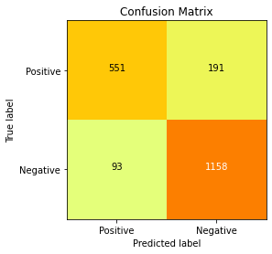
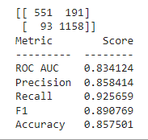
Sentimental Analysis (Supervised)
Logistic Regression
551 instances are labeled as True Positive (correctly predicted as positive)
191 instances are labeled as False Positive (incorrectly predicted as positive)
1158 instances are labeled as True Negative (correctly predicted as negative)
93 instances are labeled as False Negative (incorrectly predicted as negative)

Slide 27
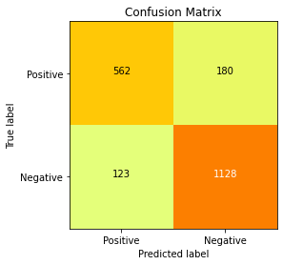
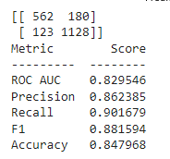
XGBoost Modelling
562 instances are labeled as True Positive (correctly predicted as positive)
180 instances are labeled as False Positive (incorrectly predicted as positive)
1128 instances are labeled as True Negative (correctly predicted as negative)
123 instances are labeled as False Negative (incorrectly predicted as negative)

Slide 28
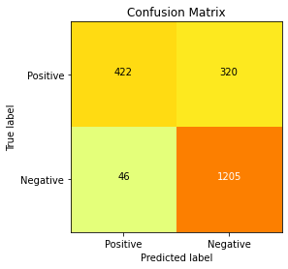

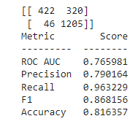
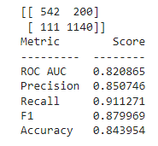
Cross- Validation & Hyperparameter Tuning
Logistic Regression
XGBoost

Slide 29
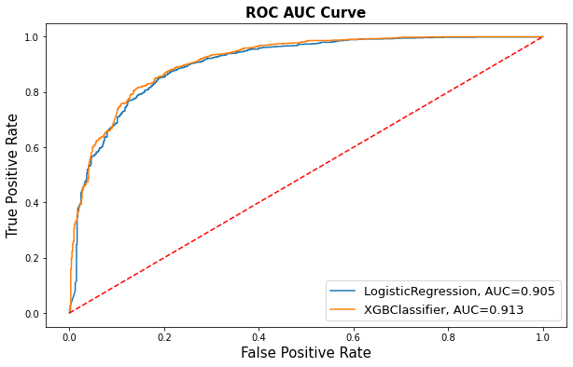

Slide 30
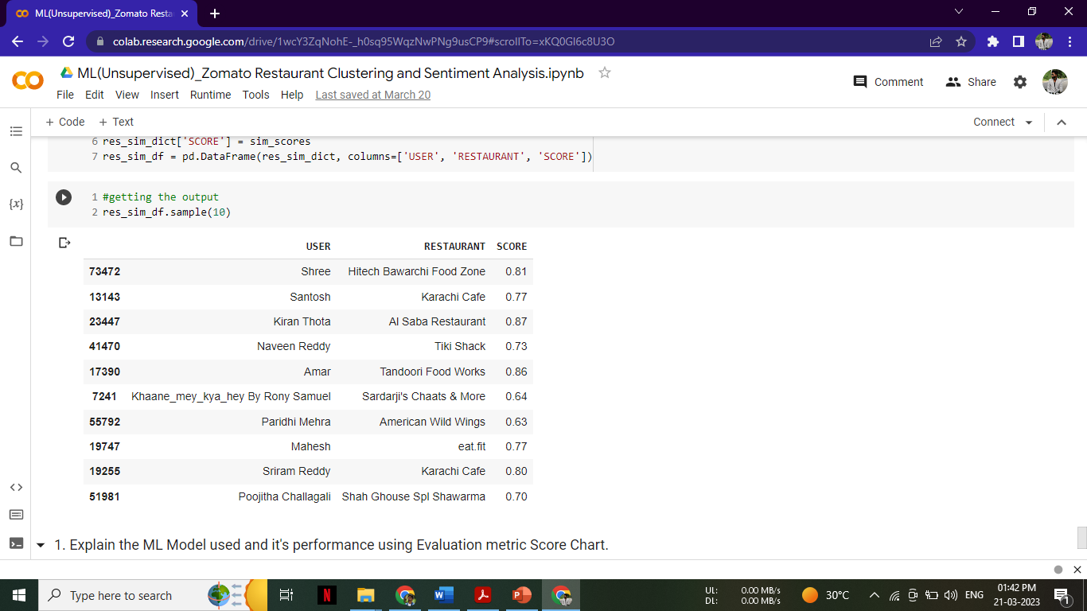
Recommendation System
Content-based filtering is a recommendation system technique that recommends items to users based on their previous preferences or interactions with items. It works by analysing the attributes of the items and user preferences, and recommending items that have similar attributes.
In a restaurant recommendation system, for example, a user's profile may include information about the restaurant genres they prefer. If a user enjoys a particular Chinese, Italian, or Indian restaurant, the system will suggest other Chinese, Italian, or Indian restaurants to them.
Content-based filtering can also be used to suggest items to new users who have yet to interact with the system. The system will recommend items based on their attributes rather than the user's previous preferences in this case.

Slide 31
Conclusion
Using a dataset of customer evaluations for the meal delivery service Zomato, clustering and sentiment analysis were conducted. To comprehend the customer's experience and learn more about their input, this analysis was conducted.
Our analysis of customer evaluations for Zomato utilized clustering and sentiment analysis to gain insights into customer satisfaction levels and identify areas for improvement. By clustering customers into positive and negative groups and using sentiment analysis to classify reviews as positive or negative, we were able to gain a comprehensive understanding of customer feedback. Our findings can be used to inform business decisions and improve the Zomato service.
From the EDA we got to know about,
AB's - Absolute Barbecues, show maximum engagement and retention as it has maximum number of rating on average and Hotel Zara Hi-Fi show lowest engagement as has lowest average rating.
Most Expensive Restaurants
Most Affordable Restaurants
Great Buffets is the most frequently used tags.

Slide 32
I have chosen XGBoost model which is hyperparameter optimized for my final prediction.
As a result of its high regularization, XGBoost is more resistant to overfitting and more adaptable to new data. With XGBoost, a supervised learning system, sentiment labels can be predicted by training on labelled data.
The ensemble aspect of XGBoost can aid in enhancing sentiment analysis performance by pooling the predictions of various models.
In sentiment analysis, when the model needs to generalize to new data, XGBoost's regularization can help to reduce overfitting and make the model more robust to unseen data.

Slide 33
Thank You

